Slide 1

Kotlin Operator
1. Arithmetic Operators 2. Assignment Operators 3. Unary Operator 4. Relational Operators 5. Logical Operators 6. Bitwise Operators 7. In Operators 8. Indexed access Operator 9. Invoke Operator

Slide 2
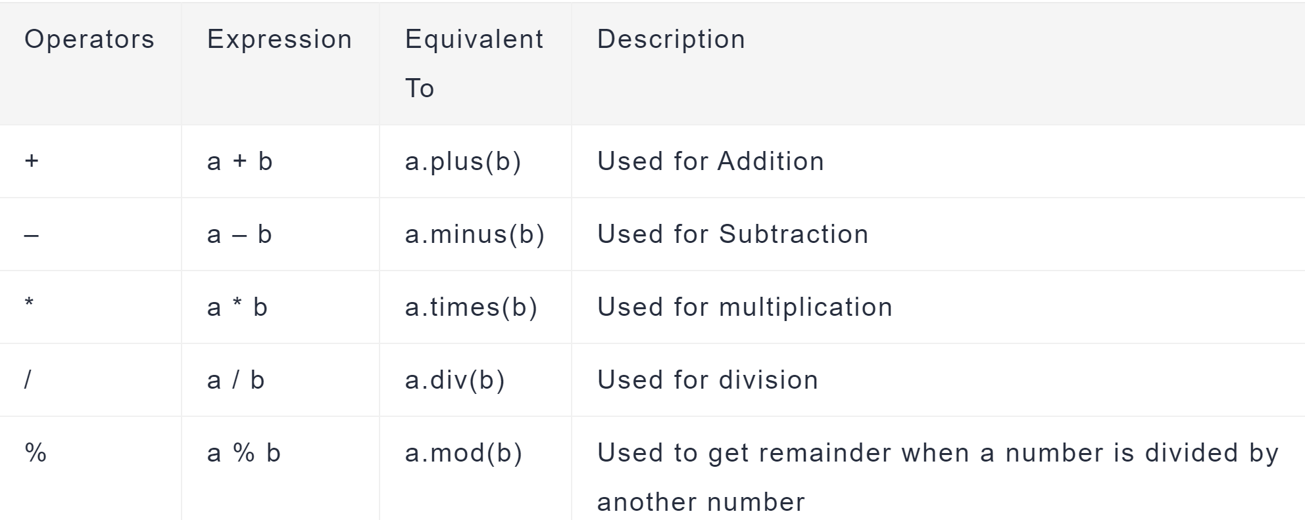
1. Arithmetic Operators

Slide 3
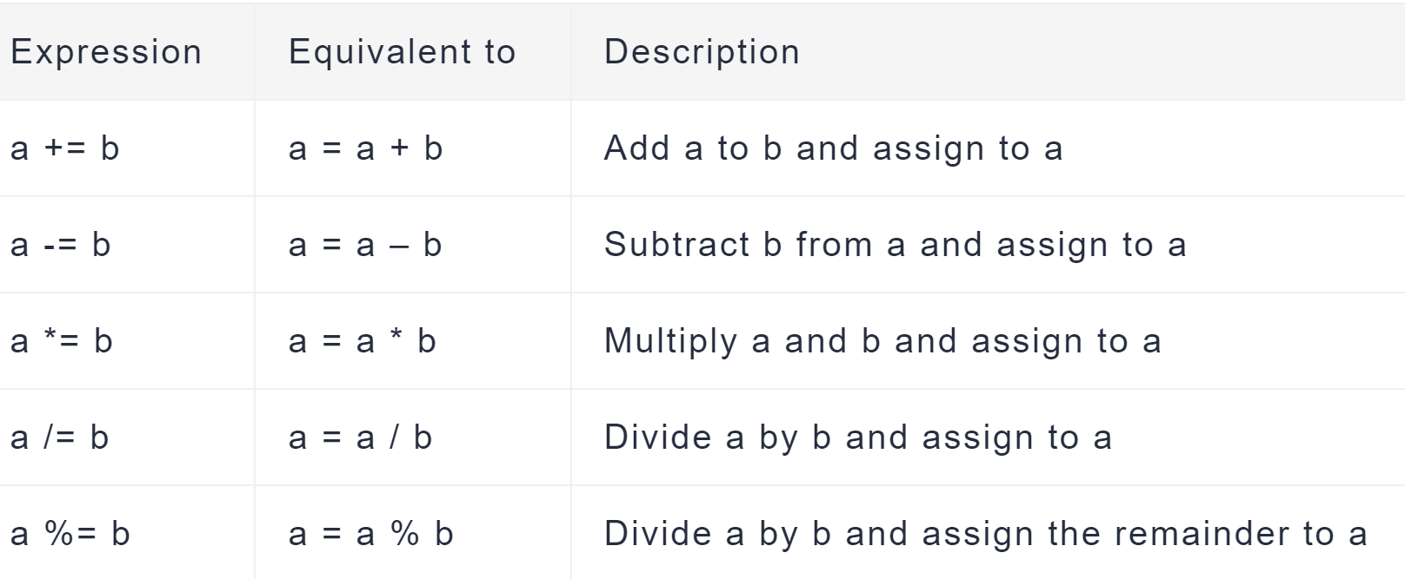
2. Kotlin Assignment Operators

Slide 4
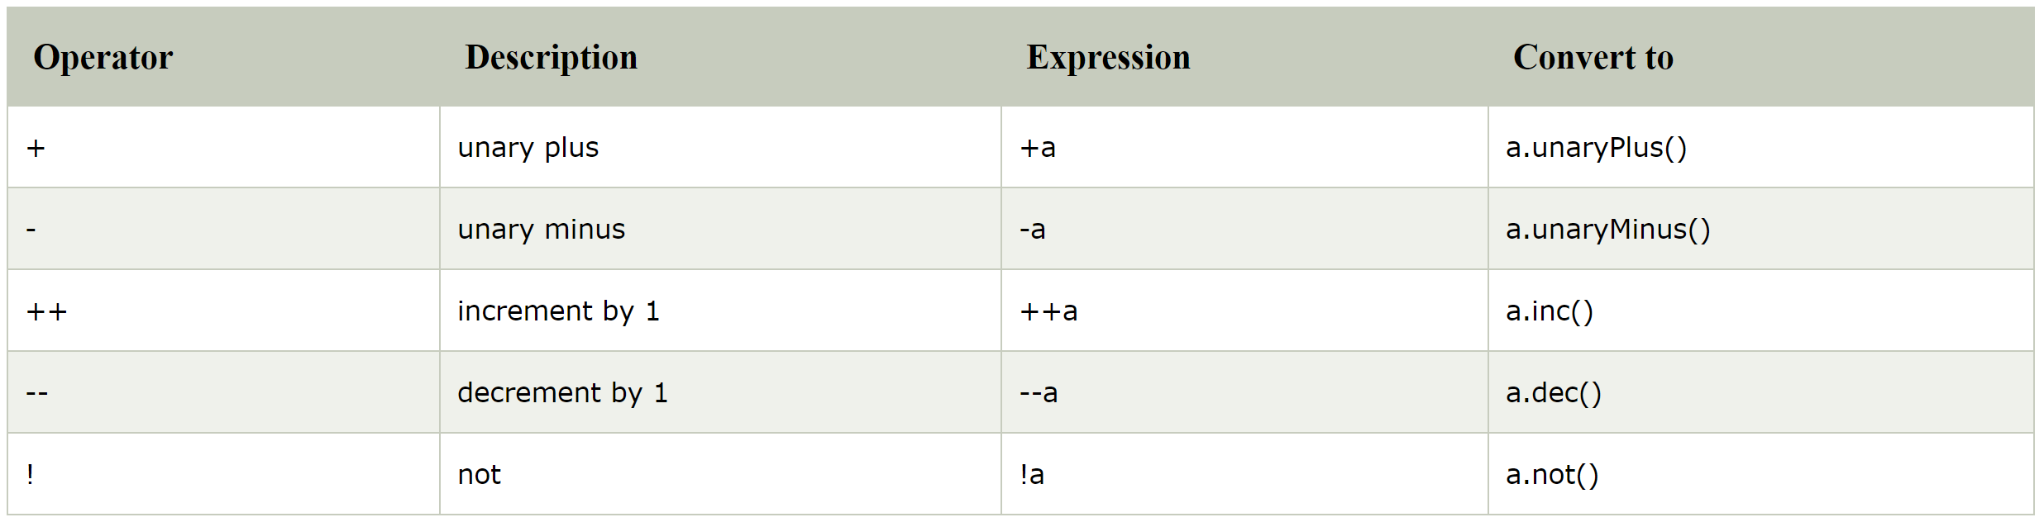
3. Kotlin Unary Operators

Slide 5
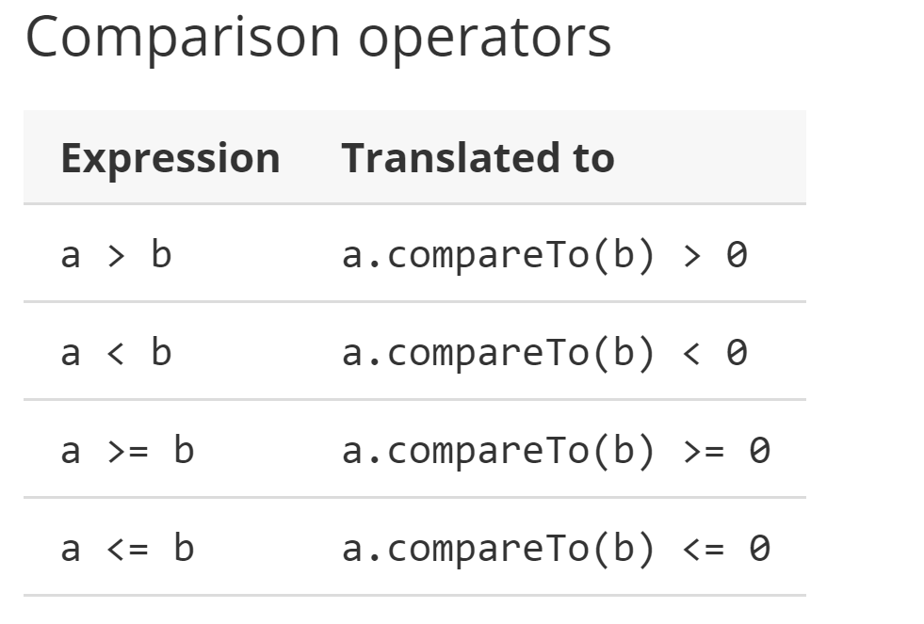
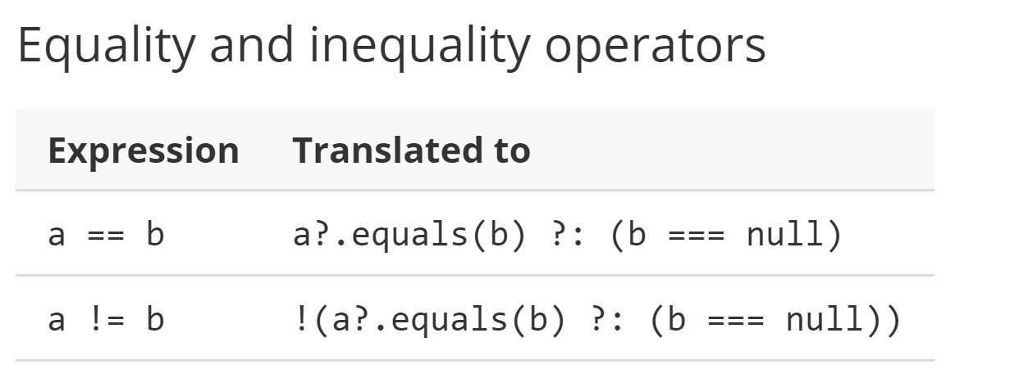
4. Kotlin Relational Operators

Slide 6
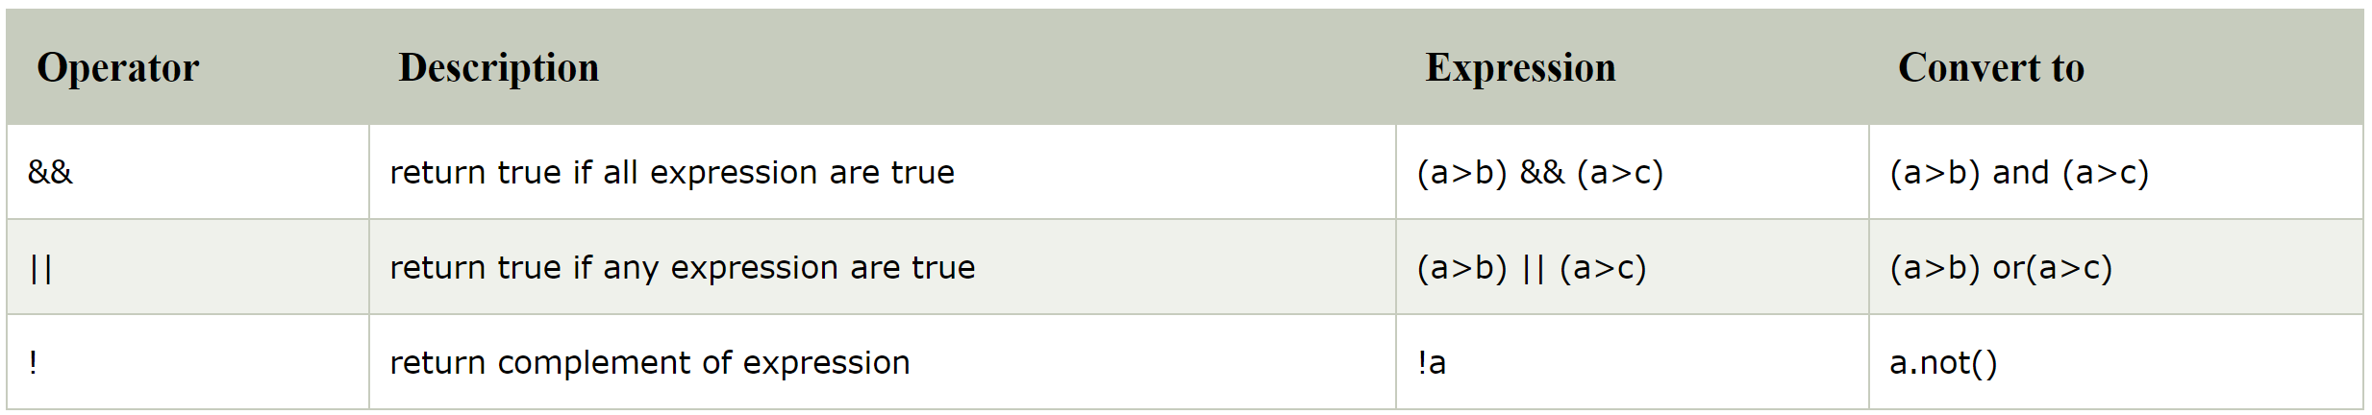
5. Kotlin Logical Operators

Slide 7
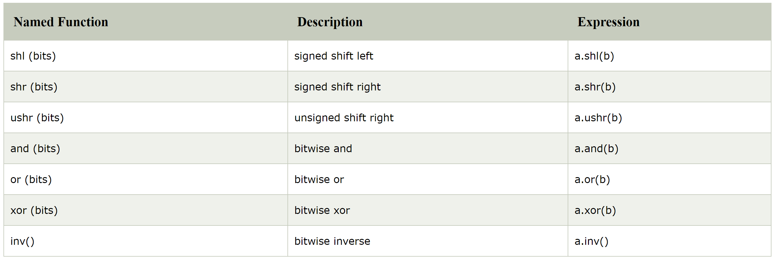
6. Kotlin Bitwise Operator

Slide 8
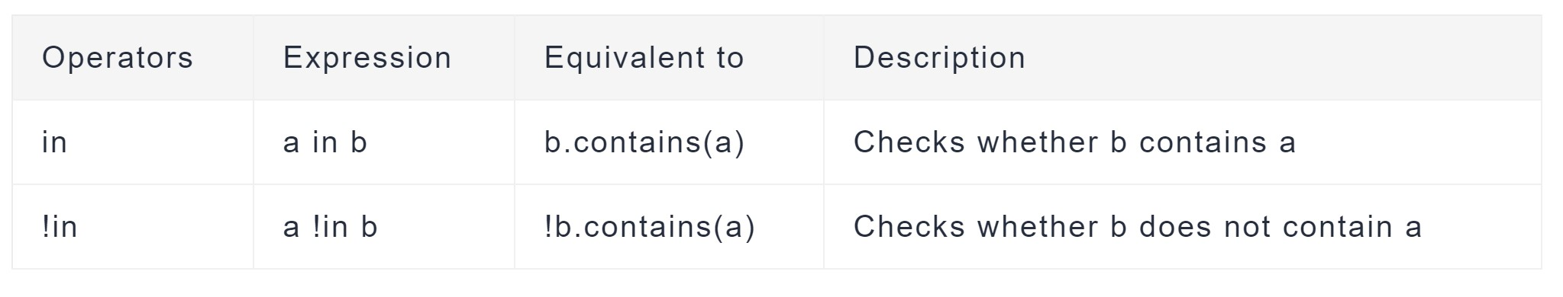
7. Kotlin ‘In’ operators

Slide 9
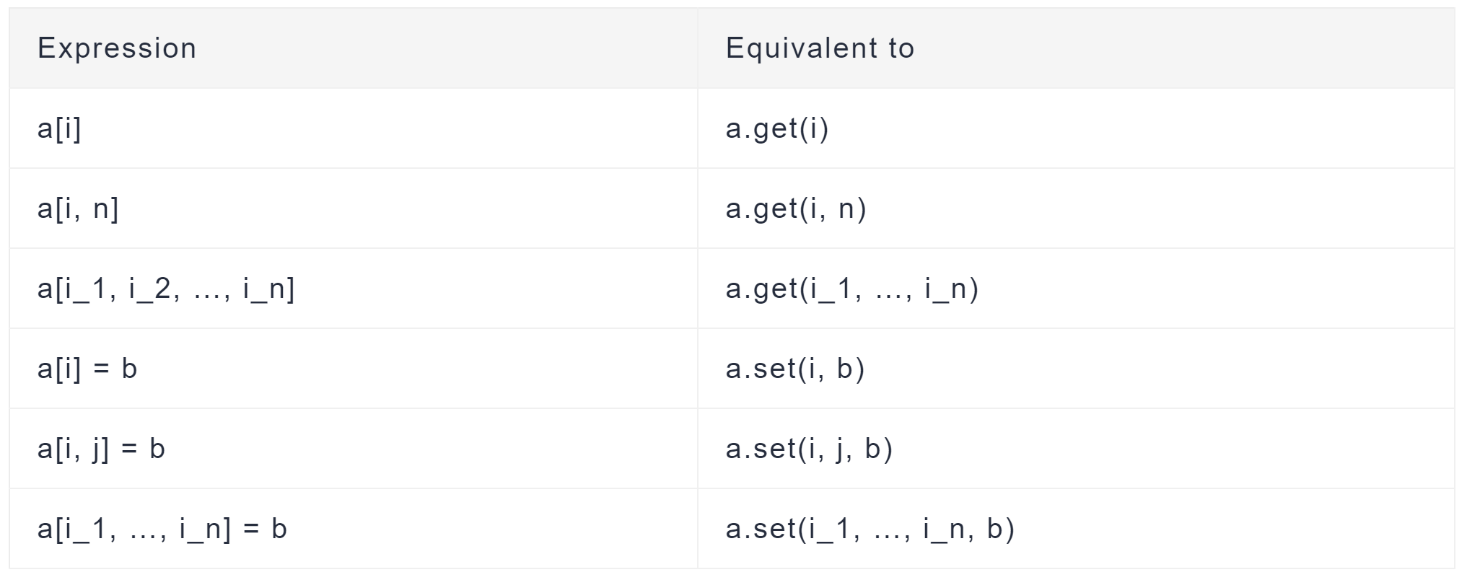
8. Kotlin Indexed Access Operators

Slide 10
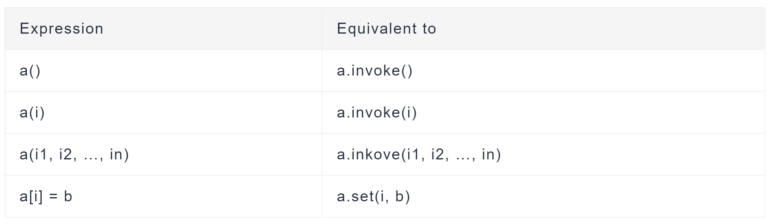
9. Kotlin Invoke Operators

